Slide 1

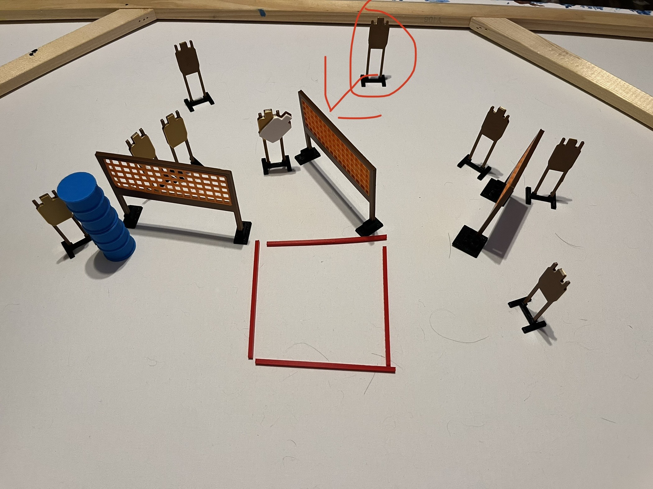
 | Dothan Practical Shooters – USPSA Match Four Corners Course Designer : Jeremy Stevens Bay: B2
Round Count 18 rounds 9 USPSA
Equipment List 6 wall feet 10 targets (9 + 1NS)

Slide 2
Four Corners
Written Stage Briefing
Scoring: Comstock Rounds: 18
Targets: 9
Handgun start position: feet on X’s, wrists below belt. Handgun is loaded and holstered.
PCC start position: feet on X’s, stock on belt. Loaded carbine is held with both hands, safety on.
Stage Procedure: on the audible start signal, engage target as they become available from within the shooting area.

